Slide 1
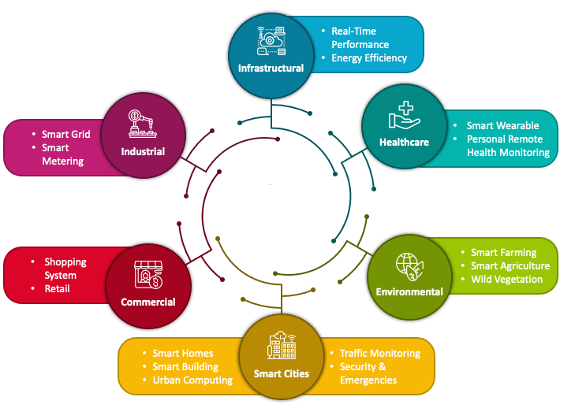

OP – Amp Apps
PDS
https://www.youtube.com/@AmelOline
Notes:
https://www.vturesource.com/vtu-syllabus/CS/2018/8/18CS81
AWS : IoT Device Simulator https://aws.amazon.com/solutions/implementations/iot-device-simulator/?did=sl_card&trk=sl_card
https://aws.amazon.com/s3/
https://www.vturesource.com/vtu-syllabus/CS/2018/8/18CS81
https://www.simplilearn.com/pgp-full-stack-web-development-certification-training-course?utm_campaign=Skillup-IOT-6mBO2vqLv38&utm_medium=Comments&utm_source=youtube

Slide 2
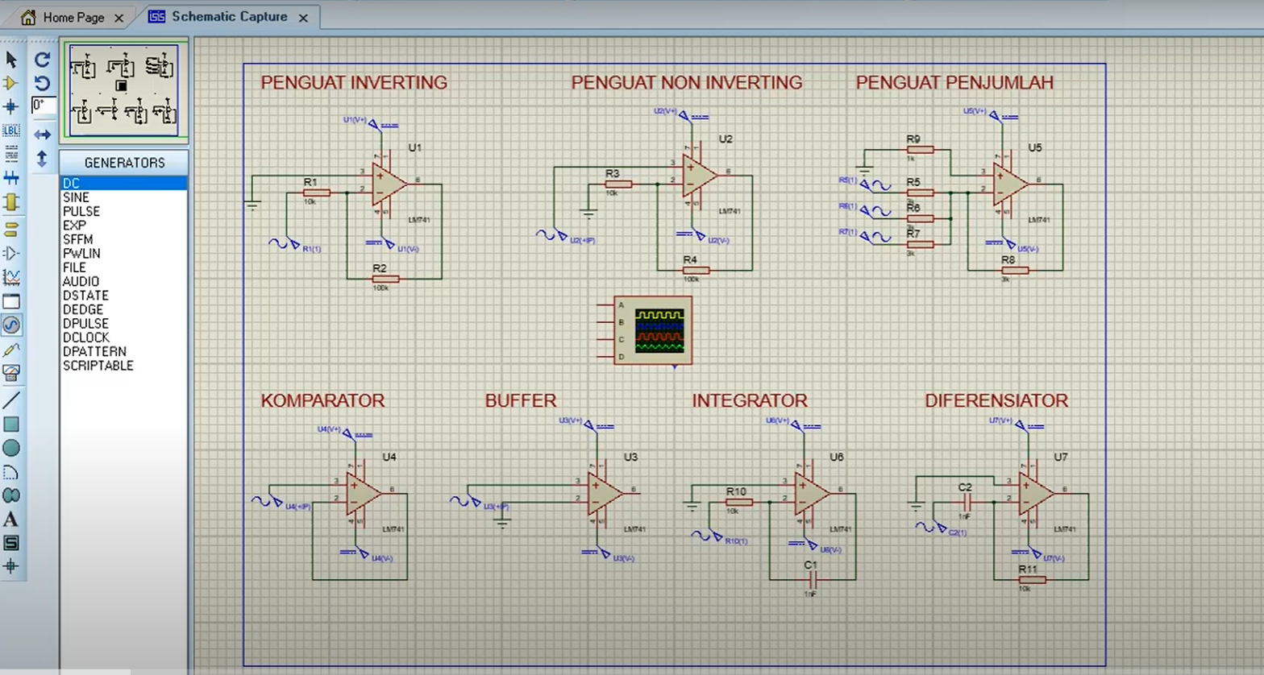
Proteus :
Notes:
https://e2e.ti.com/support/amplifiers-group/amplifiers/f/amplifiers-forum/693061/ina129-why-did-not-i-recognize-the-differences-of-ina128-vs-ina129-and-opa2134-vs-tl074

Slide 3
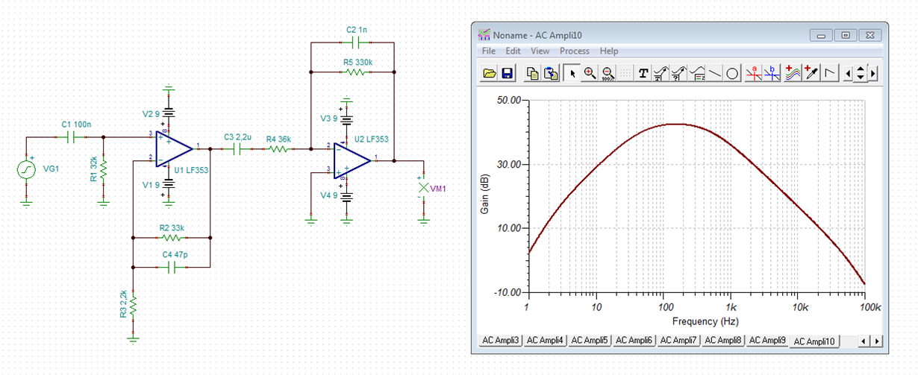
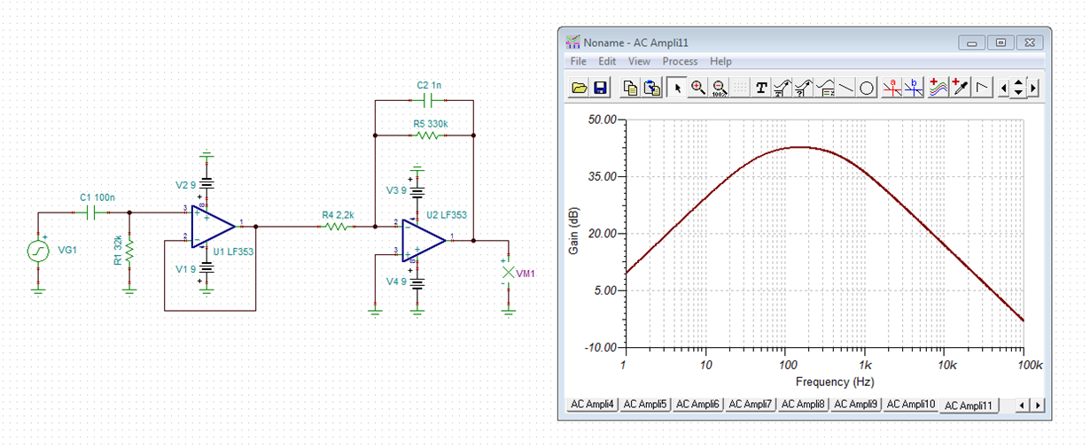
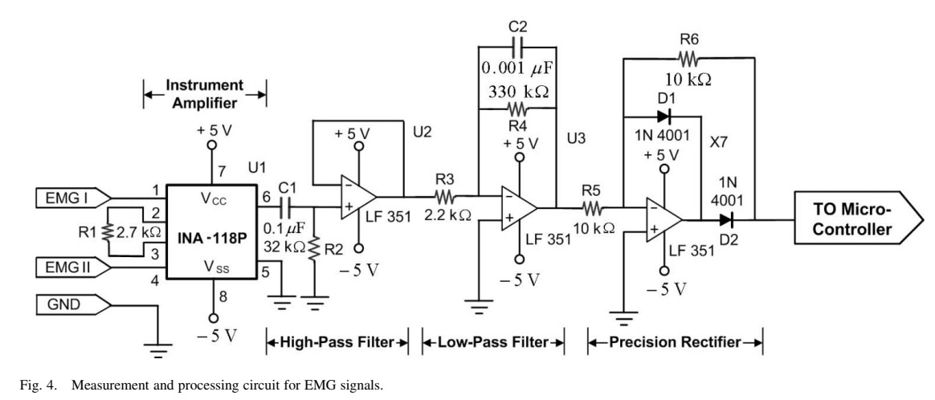
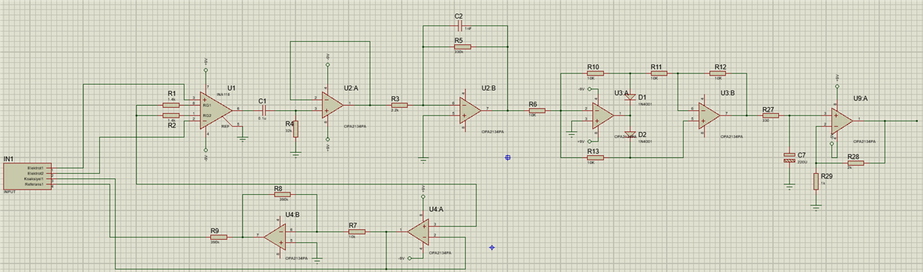
Notes:
https://e2e.ti.com/support/amplifiers-group/amplifiers/f/amplifiers-forum/693061/ina129-why-did-not-i-recognize-the-differences-of-ina128-vs-ina129-and-opa2134-vs-tl074

Slide 4
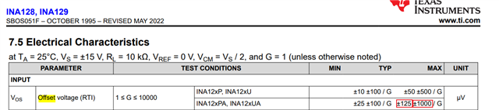
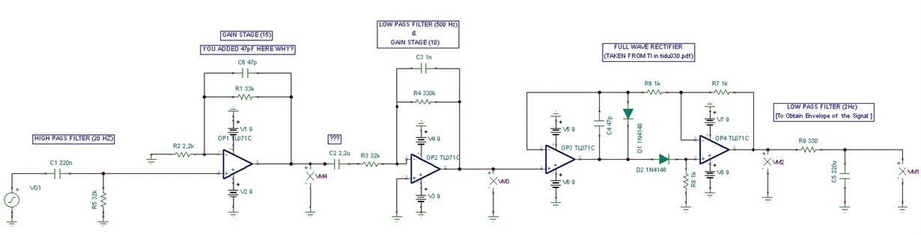
Notes:
https://e2e.ti.com/support/amplifiers-group/amplifiers/f/amplifiers-forum/693061/ina129-why-did-not-i-recognize-the-differences-of-ina128-vs-ina129-and-opa2134-vs-tl074

Slide 5
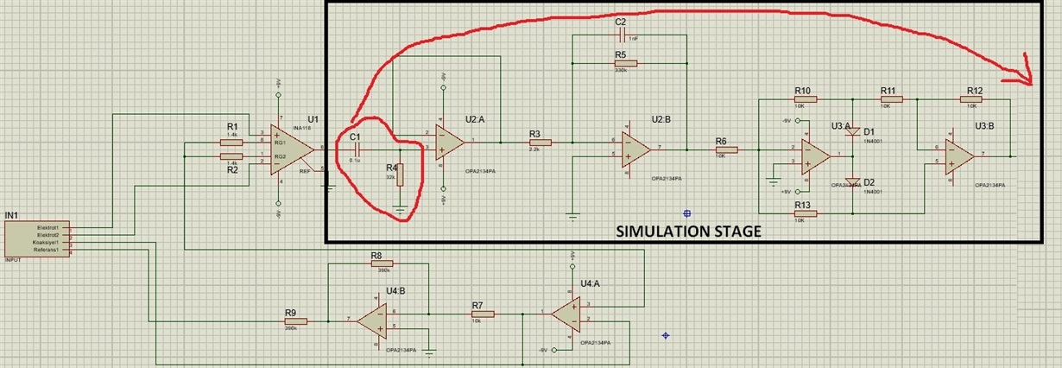
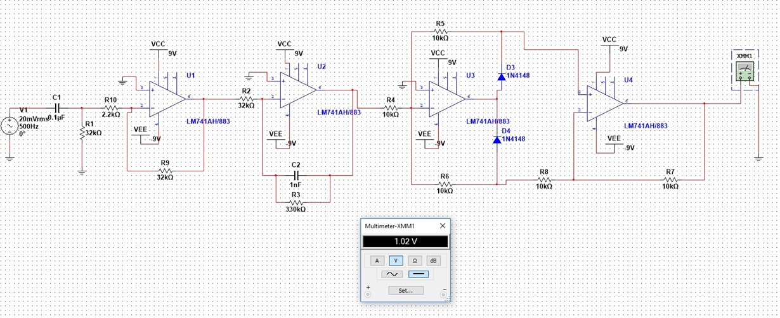
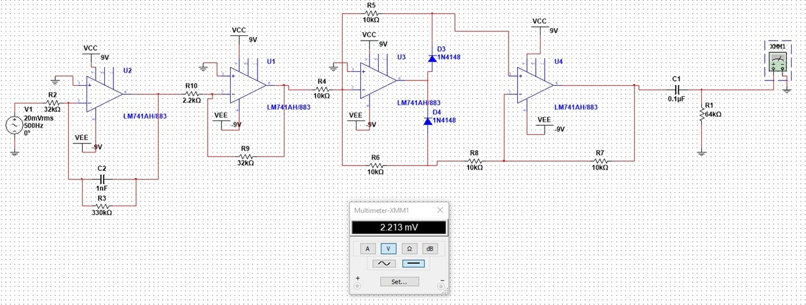
Notes:
https://e2e.ti.com/support/amplifiers-group/amplifiers/f/amplifiers-forum/693061/ina129-why-did-not-i-recognize-the-differences-of-ina128-vs-ina129-and-opa2134-vs-tl074

Slide 6
Notes:
https://www.electronics-tutorials.ws/opamp/op-amp-multivibrator.html

Slide 30
Thank You
https://www.youtube.com/@AmelOline

